Slide 1
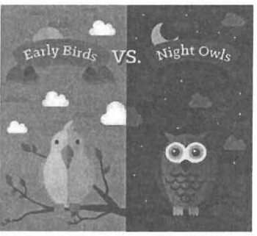
EARLY BIRDS VS NIGHT OWLS
DSE PAPER 4 · SPEAKING PRACTICE
Night Owls
Sleep patterns, body clocks
and flexible working hours
DSE 2023 Paper 4 Set 2.1 · Lesson 3
Which one are you?

Slide 2

01 WARM-UP
Two questions to get you talking
QUESTION 1 (Student A)
QUESTION 2 (Student B)
Do you wake up early
on weekends?
Do you often have problems
waking up in the morning?
2

Slide 3
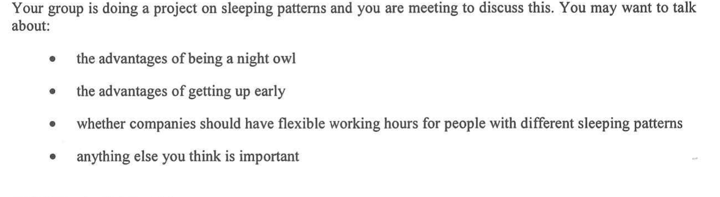
02 PART A – GROUP INTERACTION
Your discussion task
3

Slide 4

03 PART A – DISCUSS
Q1 Advantages of being a night owl
SUGGESTED IDEAS — noun phrases
a genuine late-night mental peak
uninterrupted late hours (after 10 p.m.)
a natural fit with modern work
e.g. Their body clock is inherited, so they really are sharpest after dark — when my concentration peaks, the house is quiet and I finally get chapters read.
5

Slide 5

03 PART A – DISCUSS
Q2 Advantages of getting up early
SUGGESTED IDEAS — noun phrases
head start on the day
peak alertness when exams happen
a calmer, better-prepared start
e.g. Morning people get the revision slot, the empty gym and the quiet library before anyone else is up.
6

Slide 6

03 PART A – DISCUSS
Q3 Should companies have flexible working hours?
SUGGESTED IDEAS — noun phrases
measurable gains in output
a better match between the person and the timetable
fair limits that must be admitted
e.g. When night owls were allowed to start later or work from home, the study estimated a US$277m gain in productivity.
7

Slide 7

03 PART A – DISCUSS
Q4 Anything else you think is important
SUGGESTED IDEAS — noun phrases
habits that can be changed
a school start time that fits teenage biology
a health issue, not a character flaw
e.g. Most of the extra heart risk came from smoking, poor sleep and diet — not from the body clock itself, so it is not a life sentence.
8

Slide 8

05 SPEAK FOR 1 MINUTE
Part B – Question 7
Would you consider a job that requires working at night?
SUGGESTED IDEAS — noun phrases
a good match with my body clock
practical rewards and fewer interruptions
a serious long-term health cost
On balance, I would try it short-term, but the trade-off is a sleep deficit I could not sustain.
9

Slide 9

05 SPEAK FOR 1 MINUTE
Part B – Question 8
Do you envy people who only need a few hours of sleep?
SUGGESTED IDEAS — noun phrases
the appeal of extra hours
the hidden cost of short sleep
a misconception that short sleepers are fine
The trade-off is clear: five broken hours may look efficient, but they cost me the next day’s lessons.
10

Slide 10

06 VOCABULARY UPGRADES
Say it like this — from the lesson
I burn the midnight oil most nights.
I am sleep-deprived, so I suffer from daytime drowsiness.
I try to catch up on sleep at the weekend.
My concentration peaks late at night, but not in the morning.
Long-term night work takes a toll on your health.
My productivity peaks late at night — I am an evening type.
When I am sleep-deprived, my cognitive performance is impaired.
The trade-off is clear: five broken hours cost me the next day’s lessons.
11

