Slide 1
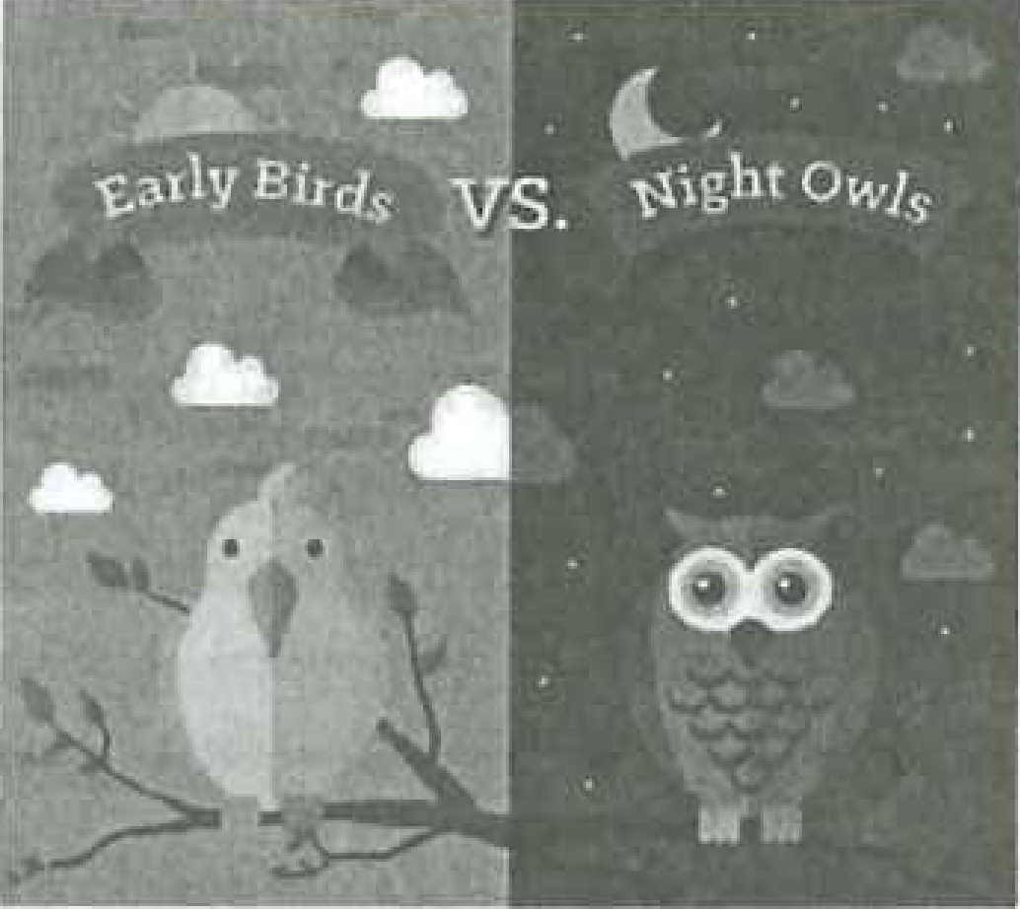
DSE PAPER 4 · SPEAKING PRACTICE
Night Owls
Sleep patterns, body clocks and flexible working hours
DSE 2023 Paper 4 Set 2.1 • Lesson 3 • Speaking Practice
Early Birds vs. Night Owls
1

Slide 2






01 WARM-UP
Warm-up
QUESTION 1 (Student A)
QUESTION 2 (Student B)
Do you wake up early on weekends?
Do you often have problems waking up in the morning?
NIGHT OWL – LATE TO BED
Sleep early · No screens before bed · Regular body clock
Netflix
YouTube
Instagram
Calm
Fitbit
Starbucks
2

Slide 3
02 VOCABULARY – LEVEL UP YOUR LANGUAGE
Level up your language: 10 expressions for this discussion
1. sleep deprivation
6. impair your concentration
instead of “not enough sleep”
instead of “make it hard to focus”
not getting enough sleep
to make thinking or focusing harder
2. sleep-deprived (adj)
7. daytime drowsiness
instead of “very tired”
instead of “feel sleepy in class”
so tired you cannot think clearly
feeling sleepy during the day
3. to burn the midnight oil
8. chronotype
instead of “stay up late to study”
instead of “my body is used to late nights”
to stay up late to study or work
your natural body clock
4. to catch up on sleep
9. flexible working hours (flextime)
instead of “sleep more at the weekend”
instead of “choose your own hours”
to make up for the sleep you lost
staff can partly choose their hours
5. take a toll on your health
10. core hours
instead of “be bad for your health”
instead of “the hours everyone must work”
to slowly damage your health
the fixed hours everyone must work
3

Slide 4
03 BUILD IDEAS
What is the hidden cost of being a night owl?
16%
higher risk of heart attack or stroke for night owls
Journal of the American Heart Association · 28 January 2026
The wider picture:
79% night owls were more likely to have poor overall heart health (AHA)
1 in 4 Hong Kong students sleep under 7 hours on school nights (CUHK)
91% of Hong Kong people who sleep under 7 hours wish they could sleep more (YouGov)
Early bird vs night owl (from the exam article)
Think about it:
➔ Night owls have a ____% higher risk of dying younger.
➔ Which other health problems does the article mention?
➔ What could happen to a night owl’s mood and schoolwork?
4

Slide 5
04 DISCUSS
Skill: Conceding a point, then countering with evidence
A: I think companies should let night owls start work later because they are more productive at night.
B: I disagree, Candidate A. That is not fair to early birds, and the office can never close.
Concede first
B*: That’s a fair point, Candidate A. I understand that early birds should not be treated unfairly. However, we should also look at the (1) ______________. In fact, the article (2) ____________ that when companies let night owls start later, there was a gain of US$277 million in (3) ____________. In other words, working with a person’s (4) ____________ benefits the whole company. I believe a system of (5) _______________________, with a few (6) ____________ in the middle of the day, would keep everyone happy. Any other thoughts?
Counter with a fact
Upgraded words – the numbers match the blanks in B*:
Pass the turn
1 evidence
2 reported
3 productivity
4 chronotype
5 flexible working hours
6 core hours
5

Slide 6
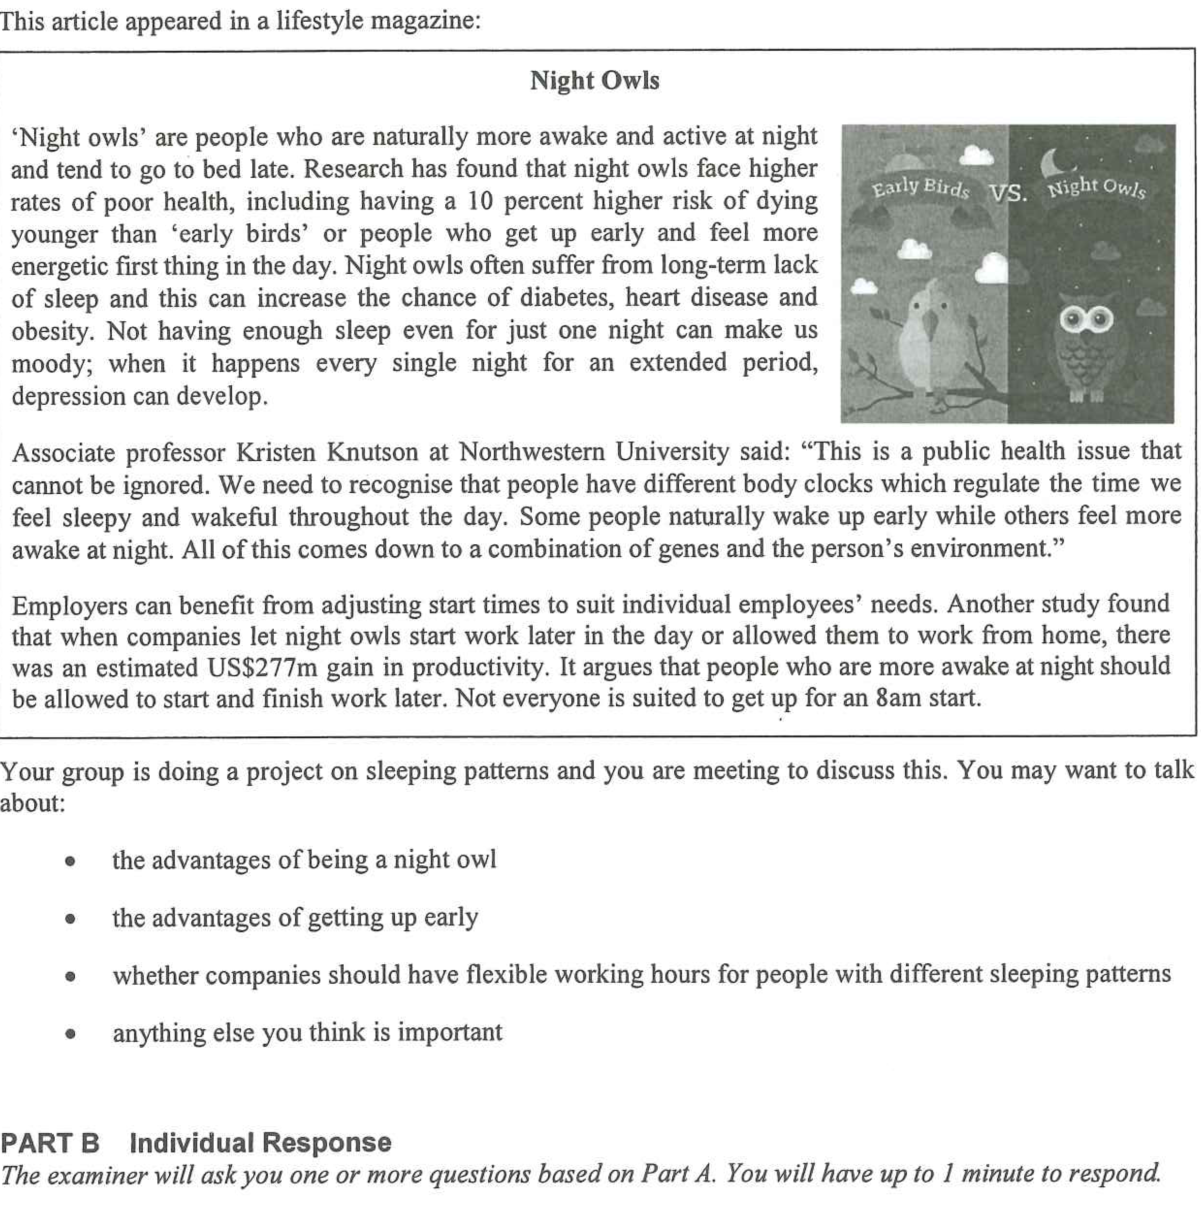
05 PART A – GROUP INTERACTION
6

Slide 7
06 DISCUSS
Ideas for your discussion
1
Advantages of being a night owl
2
Advantages of getting up early
• quiet hours – no interruptions after 10 p.m.
• creative peak – best ideas come late at night
• suits online, global or freelance work
• in sync with friends’ late-night life
• morning energy – start before you feel behind
• time to plan, revise, exercise or eat breakfast
• awake for morning lessons and public exams
• finish earlier – more free time and daylight
3
Flexible working hours?
4
Anything else important
• match work to a person’s body clock
• later starts raised productivity by US$277m
• fairness – keep some core hours
• not possible for every job (nurses, drivers, shops)
• screens and caffeine steal our sleep
• much of the risk is habits, not genes
• should Hong Kong schools start later?
• sleep protects our mood and mental health
7

Slide 8
07 SPEAK FOR 30–45 SECONDS
Part B: Individual Response practice
Would you consider a job that requires working at night?
Yes: matches my body clock, quieter, shift allowance, works across time zones
No: health risks, poor sleep, less family and social time, travelling home at night
Do you envy people who only need a few hours of sleep?
Envy: more hours for study, work and hobbies
Not envy: they are often sleep-deprived; quality of sleep matters more than quantity
8

